Slide 1
Intro to Neural Nets
Session 2: Mathematical Building Blocks & Working with Keras API

Slide 2
Session Agenda
1. Building Blocks of NNs
Tensors (and relevant mathematical operations)
Loss Functions
Backpropagation: Derivatives, Gradients & the Chain Rule (quick examples)
Optimizers
2. Building a Linear Classifier
Overview of Keras and Tensorflow.
Implementing a linear classifier in Keras (now that we know the components).

Slide 3

TPUs

Slide 4


Slide 5
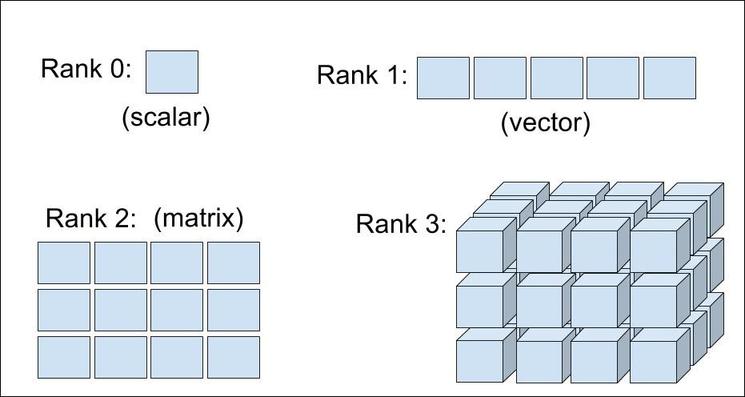
Tensors
Question: What sort of data (give an example) would be stored in a rank-3 tensor? How about a rank-4 tensor?

Slide 6
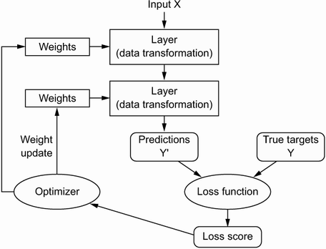
Forward Pass

Slide 7
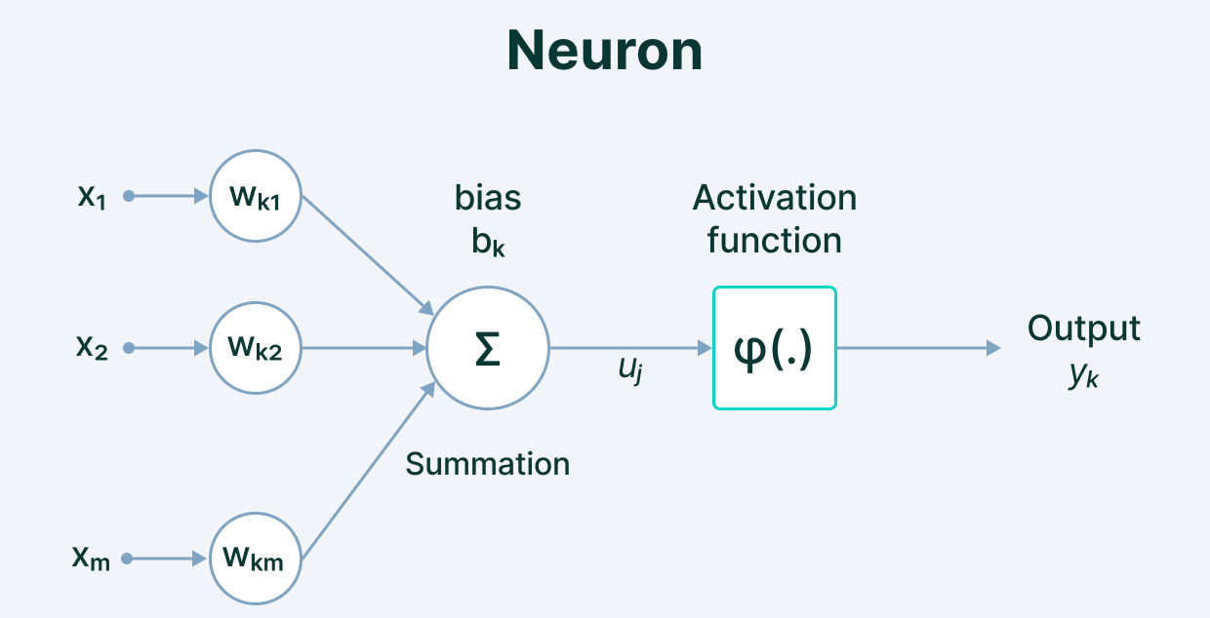
Neuron / Network Components
Question: Which of these values are fixed? Which are trainable parameters?
Notes:
We define the network structure (layers / nodes / edges) and the activate functions (within each node). Our data, X and Y (inputs and labels) are given. Our goal is then to “learn” the remaining parameters, i.e., the w’s and b’s.

Slide 8
Neuron / Network Components
Question: What is the order of operations in a forward pass?
Notes:
With one neuron this is straightforward math. However, for this to scale, we need to do all of these calculations at each node in parallel (why GPUs are useful). That means matrix multiplication and other such operations.

Slide 9
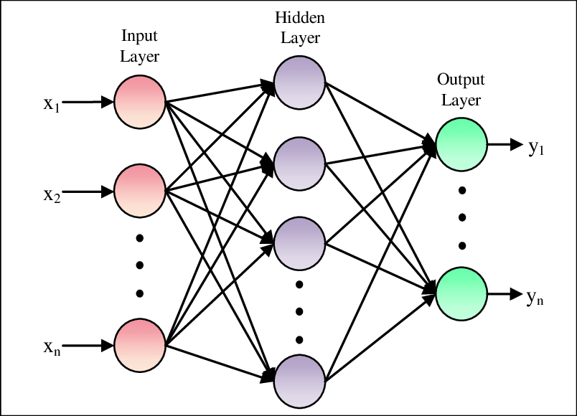



Multiple Neurons Execute in Parallel
Recall… x is our flattened digit image, a vector of 784 elements. Matrix X, which contains our 60,000 images, is thus 784 x 60,000.
For each hidden node, we need 784 weights (one weight per input value). We have 512 nodes, so matrix W is 784 x 512.
We have 512 bias terms, one per hidden node, in vector B.
Notes:
Note, for initial forward pass, we initialize w’s and b’s to small random values (not zero – if we set them all to the same value, e.g., zero, the optimization will fail, because small changes to parameters will have the same effect on the loss for every parameter, meaning the optimizer will update all of the parameters identically, and the optimizer will get stuck).

Slide 10
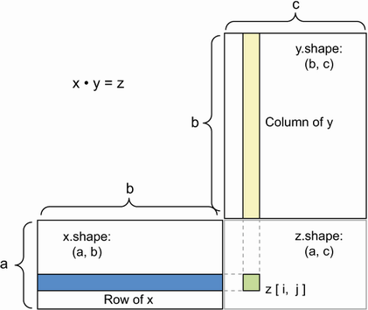
Matrix (Tensor) Multiplication
We calculate all x’s * w’s at once via matrix multiplication, i.e., W^{T}*X
Elements of the Resulting Matrix are the Dot Products of X’s Rows and Y’s Columns
Y[2,2] = W^{T}[2,:] · X[:,2]
If you get a cryptic error message about shapes not conforming, it is referring to this.
Notes:
We may not care too much about the math details, but you may encounter an error that looks like this “shape non-conformity error.”
When we do tensor multiplication (x*w), it requires that our data be in a certain format, e.g., is each of our 784 value vectors a row or a column in our matrix? This is important, because matrix multiplication requires conformity in the dimension of the two matrices we are multiplying together. This is important to know because, if you get this wrong, you’ll encounter cryptic error messages about shape non-conformity.
So, the weight matrix in a layer is defined by Keras to be # input values (columns in our data) * # nodes]. That means our input data needs to be structured as [#obs x # input values], i.e., 60,000 x 784…
Go through with example of 28x28 images, dimensionality of the matrices, etc.

Slide 11
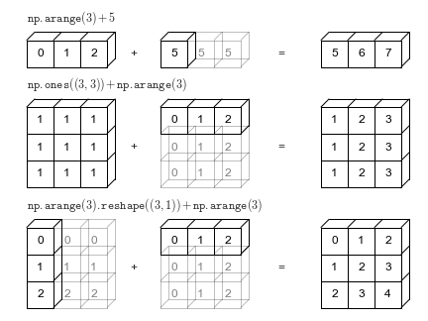
Parallel Addition Requires Broadcasting
Shape of the Two Tensors Needs to Conform
A + B will only work if len(A) is cleanly divisible by len(B).
Broadcasting
Duplicates B until it matches A’s dimensions, then performs element-wise operation.
Code might run but broadcast in a different direction than you expect, yielding a wrong answer!
Notes:
General advice – always check the shape of output when writing things from scratch. This is more important with custom implementations / layers, but when developing a complex neural network architecture, it’s not hard to accidentally implement code that runs without error but does not accomplish what you intended. This is a sort of silent error.
As an aside, this is why it’s important to know how these things work, rather than relying on someone else or AI to do it for you. It may arrive at a conceptually incorrect approach that runs without error but is not conceptually correct, and you will be none the wiser.

Slide 12
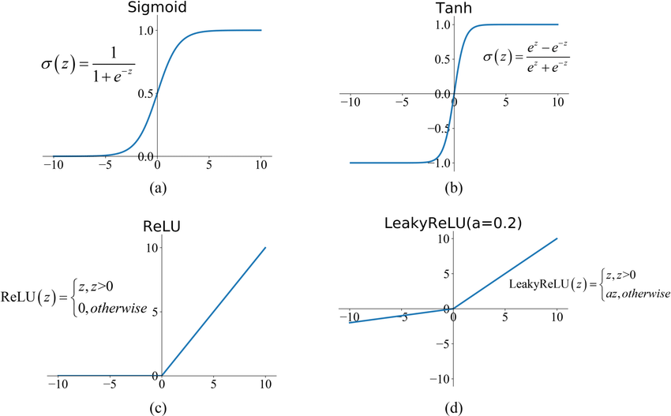
Activation Applied Element-wise
Notes:
The final step in the calculation at each neuron is applying an activation function. These are implemented elementwise to a matrix (representing a layer in the network). A single layer will generally use a common activation function.
When people first started out, they used step functions, e.g., pass a 1 if the x*w+b surpasses a threshold, like 0, else return 0. This resulted in a very unstable network. Small changes in the inputs could have massive effects on the output. This makes the ‘learning’ (optimization) very difficult.
Accordingly, we saw introduction of the sigmoid function, which still nicely bounds output between 0 and 1, but is smooth in its transition, and where the outputs are loosely interpretable as probabilities for binary outcomes taking on a value of 1. However, sigmoid also has problems; it has trouble ‘learning’ when the affine transformations get too positive or negative, because the gradient goes to 0, resulting in what’s known as the vanishing gradient problem, and its output values are strictly non-negative, which means gradients are always strictly positive or strictly negative with respect to inputs (again, presents challenges for the optimization process.
Tanh addresses the issue of gradients being of common sign, by centering the distribution around 0 (outputs range from -1 to 1), but it still has the issue of vanishing gradients for values of large magnitude.
ReLU doesn’t suffer from the vanishing gradient problem if values are positive, though it doesn’t enable any sort of learning if outputs are negative. Leaky ReLU addresses this by allowing some gradient for negative values.
A final, common activation function not shown here is Softmax, which is a multinomial generalization of sigmoid (think multinomial logistic vs. logistic regression). Softmax activation will output multiple positive values between 0 and 1, loosely interpretable as multi-category probabilities. We can’t draw this one because it’s high-dimensional in the output (not unidimensional).

Slide 13
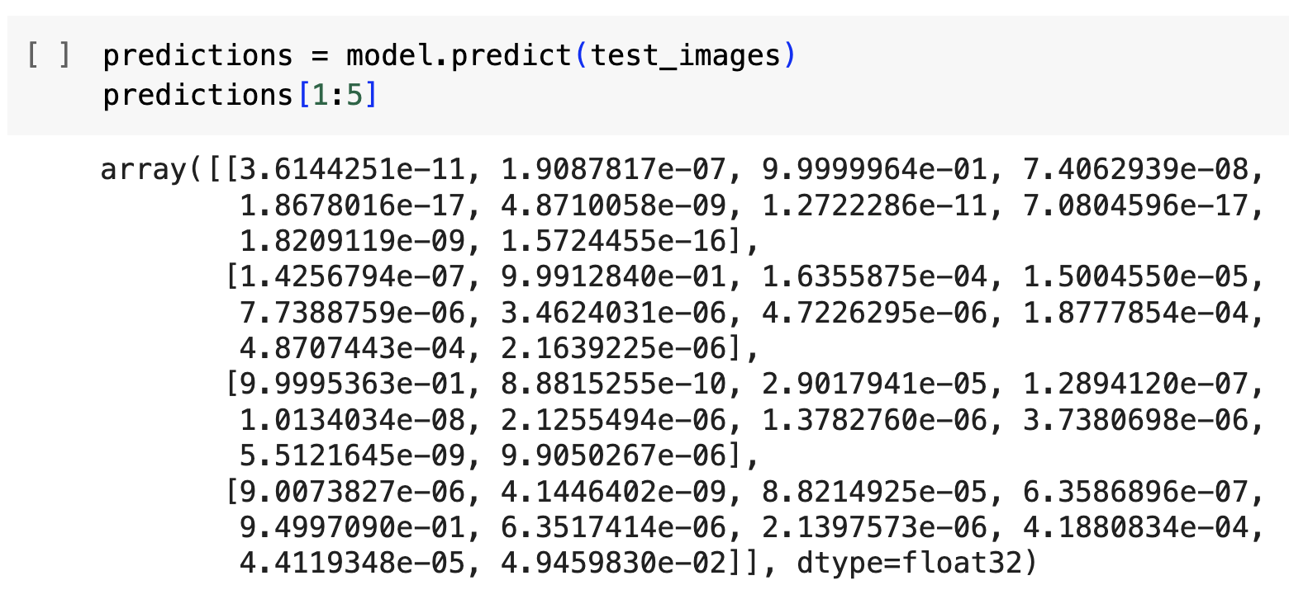
Softmax Activation
Multi-class, Single Label:
This is a generalization of sigmoid activation. Whereas sigmoid (logit) is for a single binary outcome (e.g., fraud vs. not), softmax (multinomial logit) deals with a single multi-class outcome (e.g., red vs. green vs. blue).
We only use softmax activation in the output layer.

Slide 14
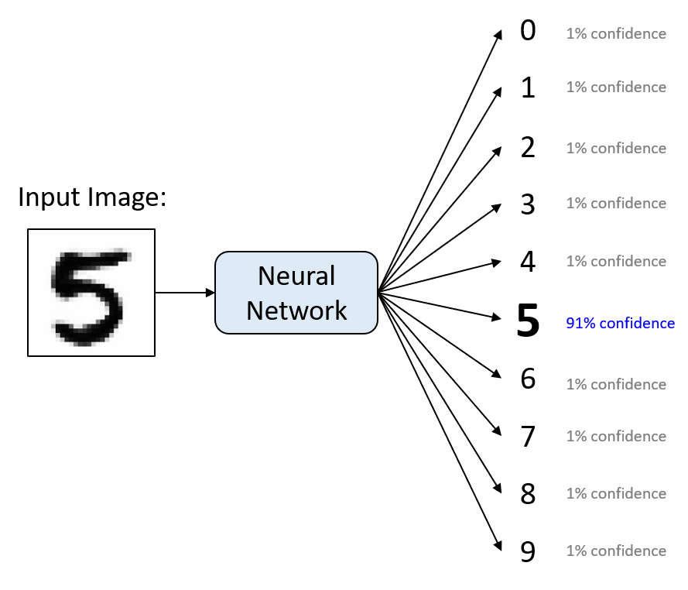
Multi-Class, Single-Label
Multi-class, Single Label:
As with sigmoid, we can loosely interpret the values output by softmax activation as probabilities.
Notes:
Values of the softmax output add up to 1.

Slide 15
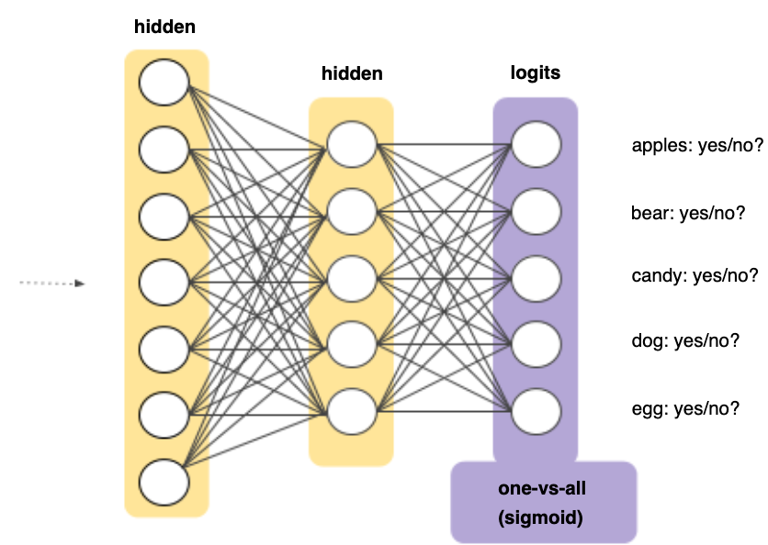
Aside: Multi-Class, Multi-Label
Many Binary Choices vs. One Multi-category Choice
We might also have an output layer comprised of many binary labels in some cases (e.g., a cat, a guitar, and a tree may be present in a photo all at the same time).
Many sigmoids versus one softmax depends on whether labels are mutually exclusive or not.
Notes:
The final step in the calculation at each neuron is applying an activation function. These are implemented elementwise to a matrix (representing a layer in the network). A single layer will generally use a common activation function.
When people first started out, they used step functions, e.g., pass a 1 if the x*w+b surpasses a threshold, like 0, else return 0. This resulted in a very unstable network. Small changes in the inputs could have massive effects on the output. This makes the ‘learning’ (optimization) very difficult.
Accordingly, we saw introduction of the sigmoid function, which still nicely bounds output between 0 and 1, but is smooth in its transition, and where the outputs are loosely interpretable as probabilities for binary outcomes taking on a value of 1. However, sigmoid also has problems; it has trouble ‘learning’ when the affine transformations get too positive or negative, because the gradient goes to 0, resulting in what’s known as the vanishing gradient problem, and its output values are strictly non-negative, which means gradients are always strictly positive or strictly negative with respect to inputs (again, presents challenges for the optimization process.
Tanh addresses the issue of gradients being of common sign, by centering the distribution around 0 (outputs range from -1 to 1), but it still has the issue of vanishing gradients for values of large magnitude.
ReLU doesn’t suffer from the vanishing gradient problem if values are positive, though it doesn’t enable any sort of learning if outputs are negative. Leaky ReLU addresses this by allowing some gradient for negative values.
A final, common activation function not shown here is Softmax, which is a multinomial generalization of sigmoid (think multinomial logistic vs. logistic regression). Softmax activation will output multiple positive values between 0 and 1, loosely interpretable as multi-category probabilities. We can’t draw this one because it’s high-dimensional in the output (not unidimensional).

Slide 16
Calculate Loss
Notes:
How do we implement the learning (optimization)? Gradient descent. We identify where we are on the loss curve, figure out a first derivative along all available dimensions (i.e., along all parameters), and proceed where the gradient is most negative (i.e., where the loss function progresses most rapidly toward zero. For this to work, we need to be able to figure out the gradient along each dimension (for each parameter) in a computationally efficient way (remember, some of the biggest models have thousands or millions of parameters!).

Slide 17

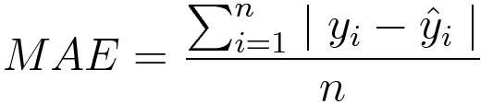
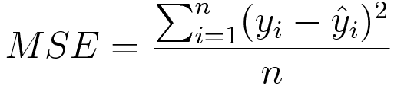

Loss Functions
Cross-Entropy / Log-Loss
Typical for binary outcomes. Value grows exponentially larger as the predicted probability moves away from the true 0,1 label.
Multi-category outcomes have an analogous loss function known as categorical cross-entropy.
MAE / L1 Loss
Typical for continuous outcomes. Errors are penalized homogenously, in magnitude and direction. This should look familiar!
MSE / Quadratic / L2 Loss
Typical for continuous outcomes, larger errors penalized exponentially more. This should look familiar!
Notes:
Note, for initial forward pass, we initialize w’s and b’s to small random values (not zero – if we set them all to the same value, e.g., zero, the optimization will fail, because small changes to parameters will have the same effect on the loss for every parameter, meaning the optimizer will update all of the parameters identically, and the optimizer will get stuck).

Slide 18
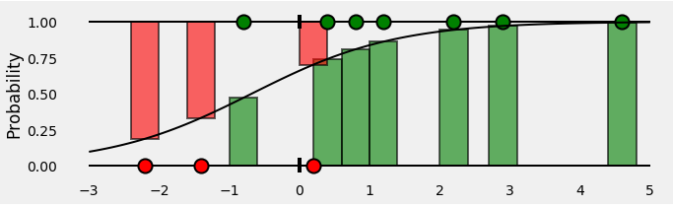
Binary Cross-Entropy Loss
Piecemeal Function:
If ground truth is 1, then loss is -1*log(p). As prediction approaches 1, loss approaches 0. As prediction approaches 0, loss grows exponentially.
If ground truth is 0, then loss is -1*log(1-p). As prediction approaches 1, loss rises exponentially. As prediction approaches 0, loss approaches 0.

Slide 19
Backpropagation
Notes:
Now for the magic, where we propagate performance backward through the network to update our weight and bias parameters. The goal here is to figure how how we should bump all the parameters (and in what direction), to reduce the error (loss).

Slide 20
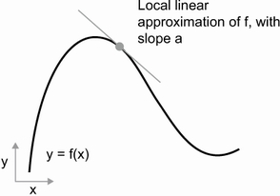
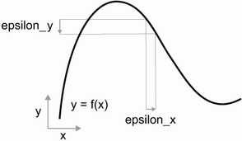
Derivative = Rate of Change
Notes:
We want to know how our loss function output will change for small increases in every parameter value. This is what a derivative tells us. For a small change in x from its current value (e.g., w_1+0.001), how will the value of y change relative to its current value (e.g., how will the loss value shift)?

Slide 21
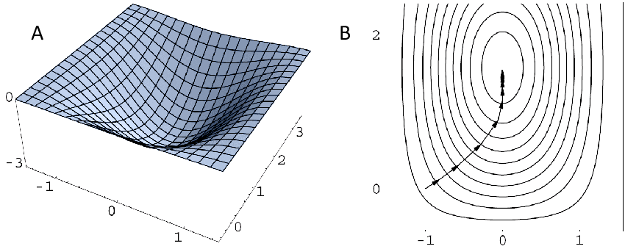
Gradient = Derivative in Multiple Dimensions
Notes:
A gradient is just a higher dimensional derivative (e.g., we figure out derivative of y with respect to its two inputs, the gradient is the derivative in that two-dimensional space. We would want to find the direction in that two-dimensional space where the gradient is steepest (most positive) and then go in the opposite direction.

Slide 22
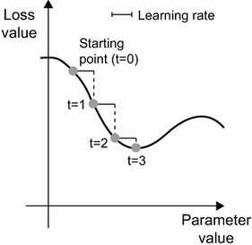
Gradient Descent
Notes:
A gradient is just a higher dimensional derivative (e.g., we figure out derivative of y with respect to its two inputs, the gradient is the derivative in that two-dimensional space. We would want to find the direction in that two-dimensional space where the gradient is steepest (most positive) and then go in the opposite direction.

Slide 23
Derivatives of Loss w.r.t ALL Model Parameters
Each Node’s Output Can be Expressed as a Function of all Prior Nodes’ Outputs
Start at the final nodes in the network and work backwards
We calculate partial derivatives that explain how Loss will change if we modify a particular weight.
We use that understanding to decide how we modify each weight for the next iteration.
So, how can we figure out the derivative of Loss w.r.t. a particular weight in the neural network? Backpropagation!

Slide 24







Simplifying Gradients: Computation Graph
Notes:
Computation graphs are implemented in TensorFlow using ‘Tape’

Slide 25
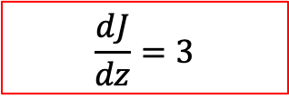
Backpropagation = Working Backwards
Notes:
Computation graphs are implemented in TensorFlow using ‘Tape’

Slide 26
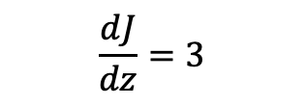
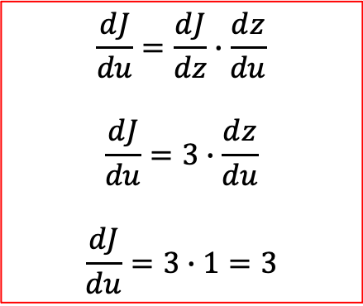
Backpropagation = Work Backwards
Notes:
Computation graphs are implemented in TensorFlow using ‘Tape’

Slide 27
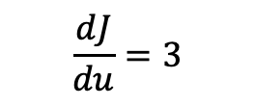
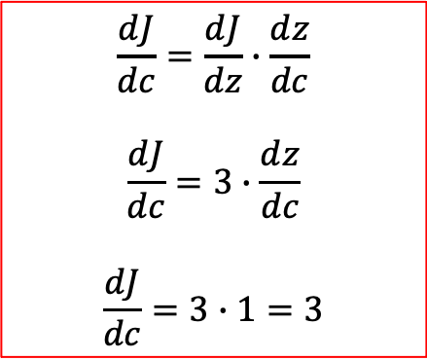
Backpropagation = Work Backwards
Notes:
Computation graphs are implemented in TensorFlow using ‘Tape’

Slide 28
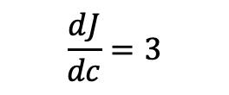
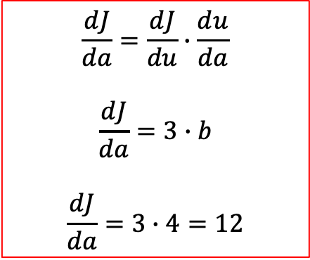
Backpropagation = Work Backwards
Notes:
Computation graphs are implemented in TensorFlow using ‘Tape’

Slide 29
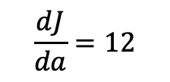

Backpropagation = Work Backwards
We thus update our parameters, a, b, and c, subtracting each’s gradients*epsilon from its current value. Epsilon is the learning rate.
Notes:
Computation graphs are implemented in TensorFlow using ‘Tape’

Slide 30



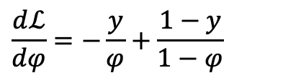


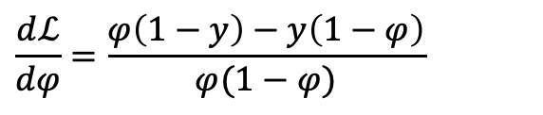


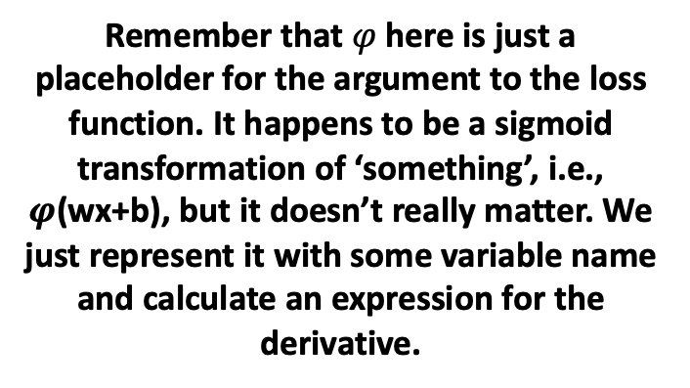
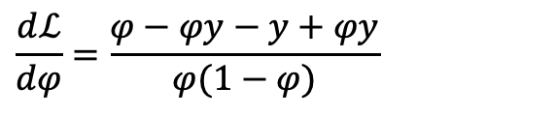
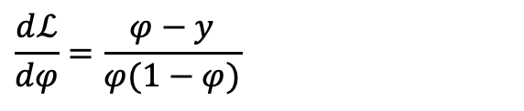
Single Node with Sigmoid & Cross-Entropy Loss (i.e., Logistic Regression)
Notes:
Loss function here is binary cross-entropy loss. Can prove that the derivative of cross entropy loss function with respect to prediction is what I have written here.

Slide 31
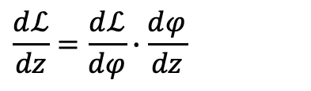
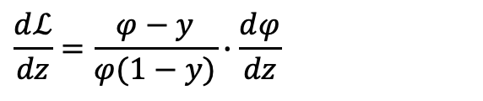
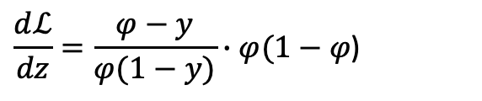
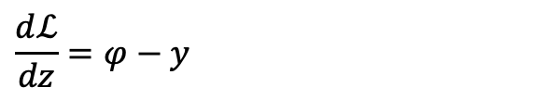

Single Node with Sigmoid & Cross-Entropy Loss (i.e., Logistic Regression)
Now we calculate derivative of the sigmoid with respect to its argument, z.
Notes:
You can rearrange to show the final step in sigmoid derivative…

Slide 32



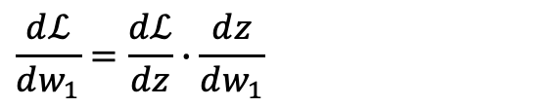

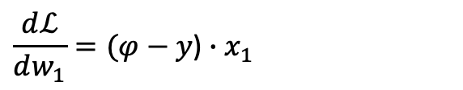
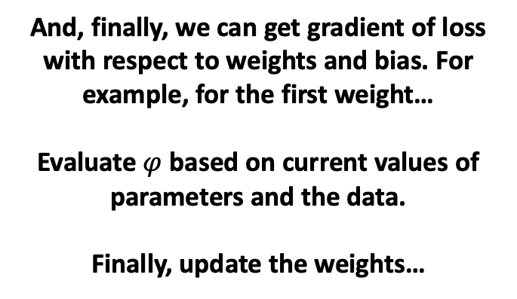
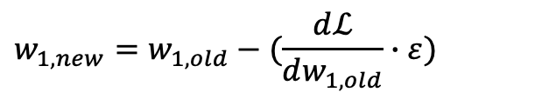
Single Node with Sigmoid & Cross-Entropy Loss (i.e., Logistic Regression)
Notes:
You can rearrange to show the final step in sigmoid derivative…

Slide 33

Tensorflow GradientTape: AutoDiff
1. Gradient Tape
A Tensorflow function that automates the calculation of derivatives.
It constructs a computation graph in the background and implements codified rules for calculating derivatives of functions.
You could technically use gradient tape to implement a gradient descent algorithm for many optimization problems.

Slide 34
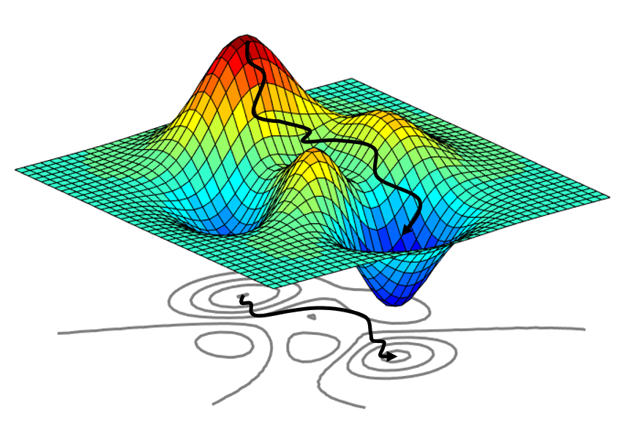
Optimizers
Keras Supports 8 Optimizers
SGD = Stochastic Gradient Descent
Momentum
Ftrl (2010) = Follow the Regularized Leader
Adagrad and Adadelta (2012) = Adaptive Gradient Descent
RMSprop (~2012) = Root Mean Squared propagation
Adam (2015) = Adadelta / RMSProp with Momentum.
Adamax, Nadam are extensions to Adam.

Slide 35
SGD: Gradient Descent
Types of GD
Batch GD = Use all the available training data in each pass.
Works well if the loss surface is smooth and lacks any saddle points / valleys.
Stochastic GD = Mini-batch with batch size = 1.
If troughs / saddles exist, we move past them as our exploration of gradients for the model will vary withe a given observation that we are considering in an iteration.
Computationally quite burdensome but performs well on non-linear problems (eventually).
Mini-batch GD = What we have been doing so far (randomly split the data in each epoch, into folds, and then cycle over the folds for training).
This is a happy-medium between batch and stochastic GD.
Role of Batch Size
Empirically has been observed that smaller batches yield less overfitting (because of implicit noise in the training process – variance of the gradients obtained will go up).

Slide 36
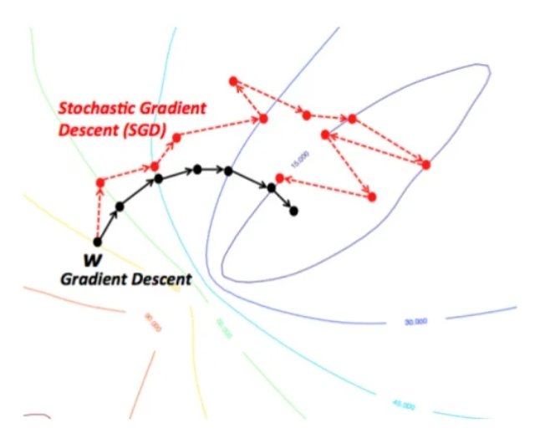
Batch (All) vs. Stochastic (1)
Same Convergence
If you have a convex surface, either approach will converge to the global optimum (no guarantee your problem is convex of course). Always converges at least to a local minimum.
Tradeoffs
Batch, each step is slower, more computationally burdensome, but convergence with fewer iterations; Need to be able to hold the entire dataset in memory.
SGD makes noisier updates, and requires more iterations to converge, but a single iteration is quick. Only need one observation in memory at a time.

Slide 37
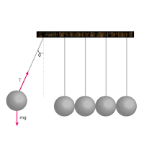
Momentum
Getting Past Local Minima
SGD gets stuck in local minima; the idea of momentum is to make updates be a function of current gradient*learning rate, as well as some fraction (decay) of the update you made last iteration.
This reduces updates to parameters where the gradients are flipping sign and amplifies updates to gradients that are going in a consistent direction (steeply descending).

Slide 38

FTRL
Google Developed in 2010…
This is an optimization technique that is used in “online” learning; it’s typically used in situations where your model training is happening continuously as new data arrives, and where drift might therefore happen.
It works well in situations where you have a ton of sparse features.
Was originally used for predicting conversion in online advertising systems.

Slide 39
Adagrad & Adadelta (RMS Prop)
Adaptive Gradient Descent (Variable Learning Rate)
We implicitly apply a high learning rate for features we have been updating very little so far (speed up movement through saddle points, for example).
We implicitly apply a low learning rate for features we have been updating a lot so far.
Technically learning rate is removed from the process, every update is a function of past updates.
Adadelta
Same idea but we use a sliding window of previous updates to determine magnitude of current updates (rather than all prior updates).
RMSProp is conceptually very similar but was independently developed (around the same time).

Slide 40
Note: Sequential vs. Functional API
We Have Only Seen Sequential API So Far
Sequential is easy to work with but is also very inflexible. Can only really handle basic feed-forward networks. It automatically figures out the shape of each layer’s output tensor and specifies the next layer’s input shape accordingly.
Functional API Let’s You Construct Any Topology You Want
We will see the difference in how each API is used, syntactically.
Syntactic Simplicity
Architectural Flexibility
Sequential API
Functional API

Slide 41
Recap
Building Blocks of NNs
Tensors and Tensor Operations
Activation Functions
Loss Functions
Backpropagation: Derivatives, Gradients & the Chain Rule
Procedure of Minibatch Stochastic Gradient Descent
Grab a batch of observations (samples)
Predict their labels using current weights / bias terms.
Calculate loss value.
Calculate gradient of loss w.r.t. all weight / bias terms.
Update each weight by subtracting its gradient*learning rate
Cycle over the whole training dataset (each cycle is an epoch) repeatedly, until loss is small.
Notes:
Note that I don’t expect you to implement a neural network from scratch. This is just to give you an understanding of how they work.

